Slide 1
Force Directed Graph Drawing
Vishrut Sharma

Slide 2
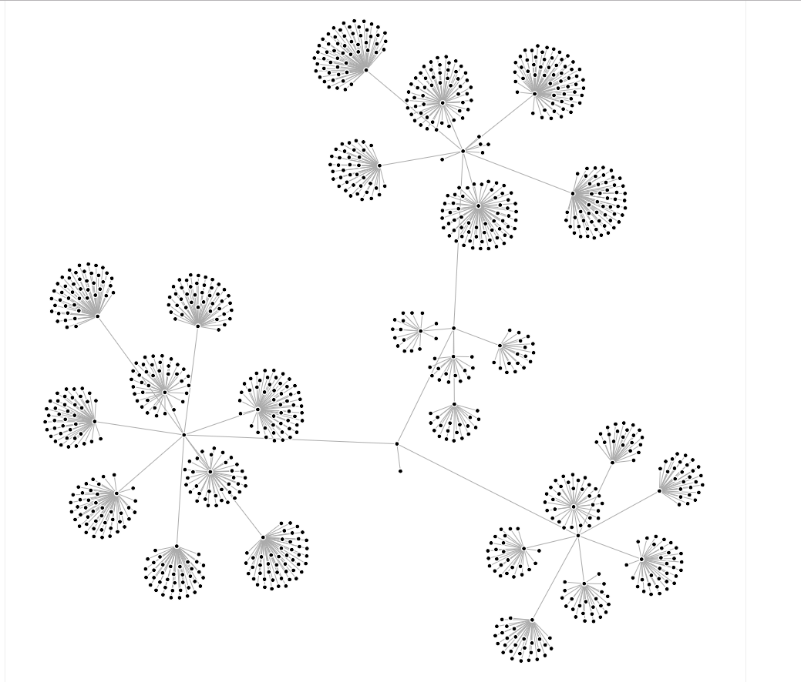
Force Directed Algorithms
Used to draw graphs
View the graph as being a virtual physical system
Vertices : Bodies of the physical system
All bodies have forces that are acting between them
All forces are calculated based upon some properties of physics
Eg : Magnetic repulsion or gravitational pull

Slide 3
Force Directed Algorithm
Class of Algorithms for drawing graphs in an aesthetically pleasing way
Position the vertices in a 2D or 3D space so that all edges have equal length
Reduce the number of crossings over the edges.

Slide 4
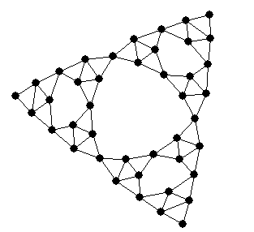
Properties
Proximity Preservation
Similar nodes are drawn closely
Symmetry Preservation
Isomorphic sub-graphs are drawn identically
No external influence
The graph is self explanatory
Notes:
Self explanatory : if any subtlr clusters are formed then they will automatically stand out

Slide 5
Force Directed Method
Nodes :
Objects of a physical system
Interact with other nodes based upon a predefined force.
Edges:
Connection objects on nodes
No interaction between edges
Add external forces on node objects
Goal : Reach equilibrium so that the sum of forces on all objects = 0

Slide 6
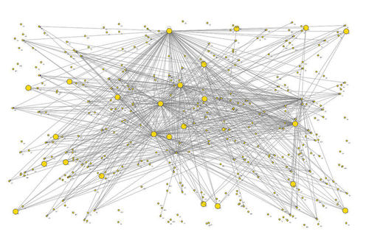
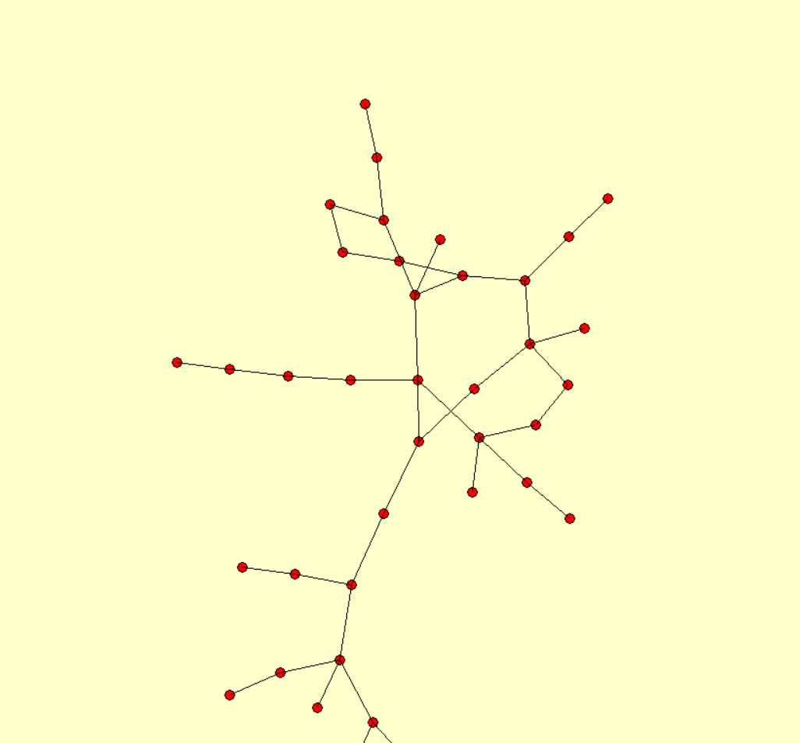
Which Layout is easier to understand
Every graph is associated with an energy function
Graphs with lower energy show better layouts

Slide 7
Algorithms
Spring Embedders :
Use mechanical spring and electrical forces
Barycentric method :
Uses length of edges as attractive force to form a convex polygon
Notes:
Model graph-theoretic distance with Euclidean distance
The forces try to place vertices so that their geometric distance in the drawing is proportional to their graph theoretic distance
For each pair of vertices (u, v), δ(u,v) is the graph-theoretic distance between them;
Number of edges on a shortest path between u and v.

Slide 8


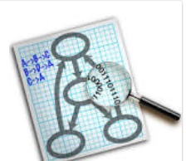
Applications
Bioinformatics – Visualizing molecular interaction networks – Cytoscape
Social Networks analysis : Analyzing twitter traffic data and global connectivity - Gephi
Open source softwares like : GraphViz
Information visualization in relational data – Tulip
Notes:
Graph viz often used in modelling graphs relating to software development and networks.
Developer : AT and T labs

Slide 9
Spring Embedders
Implemented by Eades in 1984
Algorithms calculate layout of the graph using information only contained in its structure
Advantage : No domain specific knowledge is required.
Forces used :
Attractive forces : Adjacent nodes
Repulsive forces : all non adjacent nodes
Simulate the motion of the edges and nodes or to minimize their energy
Notes:
Attractive forces : used hookes law
For repulsive forces used coulomb’s law

Slide 10
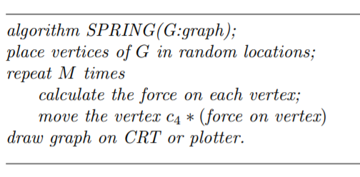
Implementation
Define the graph structure onto a file
Specify the no. of nodes , edges and connectivity
Build an adjacency matrix for the specified graph
Implement the attractive and repulsive forces on all vertices
Attractive forces – Hooke’s Law
Repulsive forces – Coulomb’s law
Calculate potential energy
Iterate till PE reaches 0

Slide 11
Dataset
Initially defined uniform adjacency matrix representation for grid shaped graphs of varying number of nodes
Defined our own input files for testing output graph structures
Used the AT & T real time graphing dataset to simulate over graphs
Recorded results over different number of nodes and structures formed.

Slide 12
DEMO

Slide 13
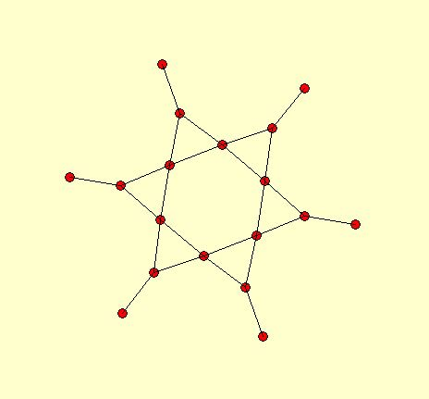
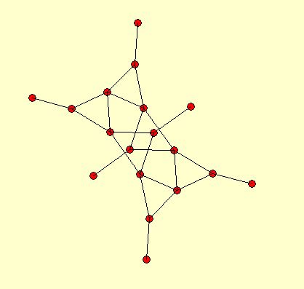
Custom Dataset

Slide 14
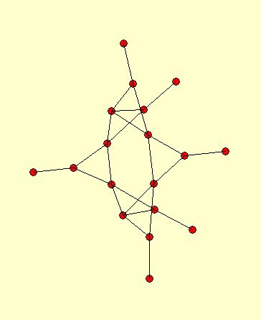
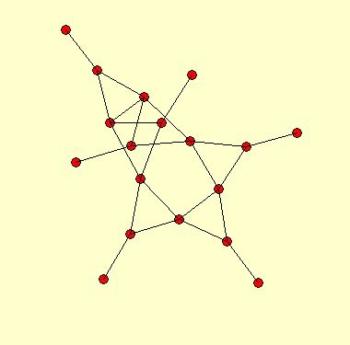
Custom Dataset

Slide 15
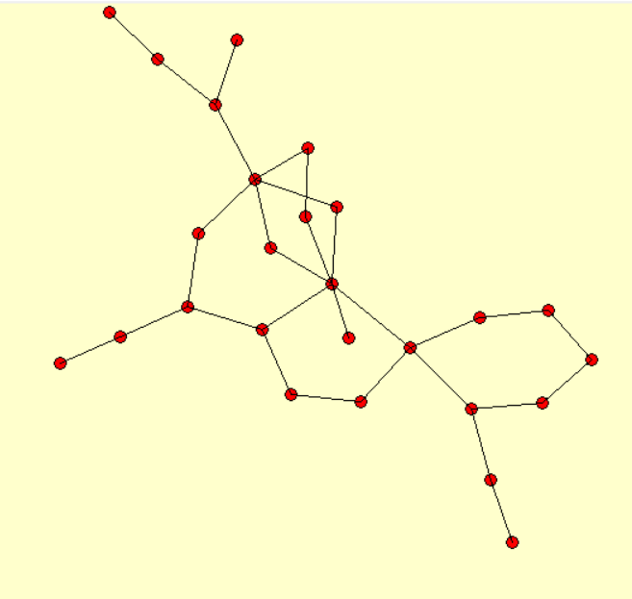
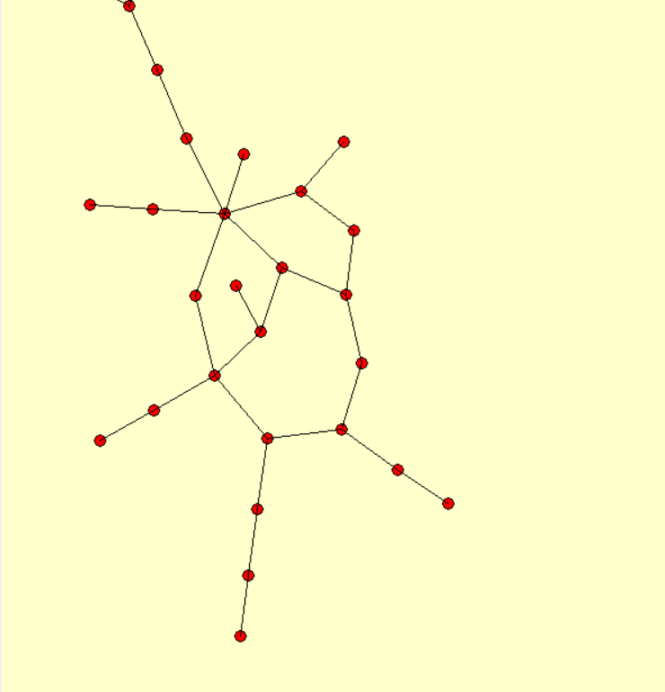
AT & T Dataset

Slide 16
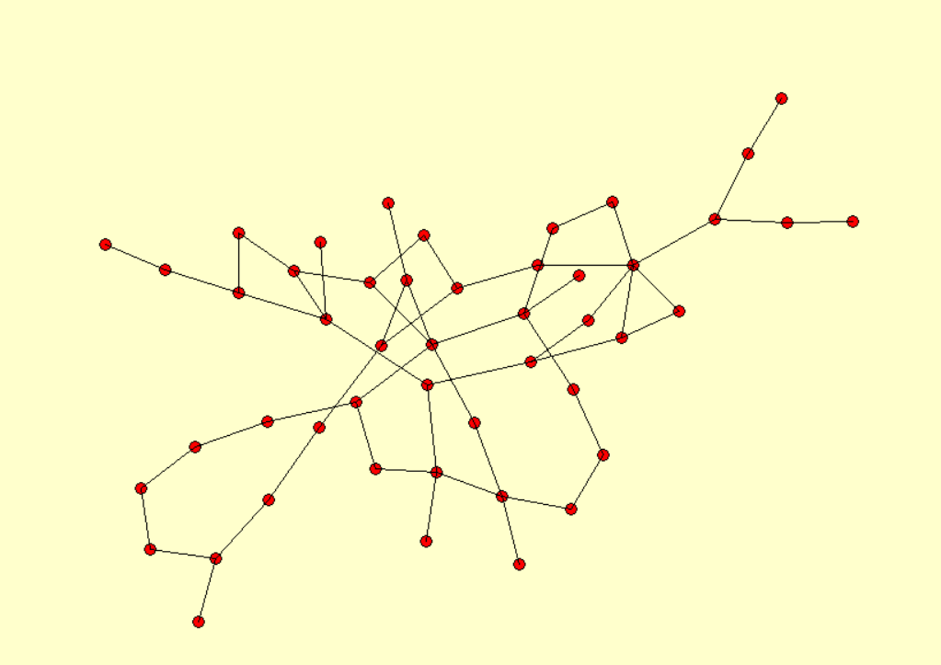
AT & T Dataset

Slide 17
Challenges
Scaling with large graphs – Algorithm does not scale well with very large graphs
Visualization issue – Not enough drawing area to show fully constructed force directed graph
Algorithmic issue – Convergence to an acceptable layout takes longer time.

Slide 18
Complexity
Complexity per single iteration is O(V²)
Energy contains at least one term for each node pair (repulsive forces)
Estimated number of iterations to convergence is O(V)
Overall time complexity is ~ O(V³ )
Force directed methods do not scale up well to large graphs

Slide 19
Results
The algorithm works well for graphs where number of nodes is < 50
Crossings are minimized and symmetrical structure obtained for most runs over a graph
The Potential energy of nodes stabilizes for graphs with less than 40 nodes and upto 100 edges.
Algorithm produces poor results for very large graphs > 100 nodes

Slide 20
Future Work
Classical force directed algorithms are unable to handle larger graphs due the inherent N squared cost at each time step.
The FADE layout paradigm, overcomes this computational limitation to allow large graphs to be drawn and abstractly represented.
Implement FADE to improve performance and visualize larger graphs

Slide 21
References
S. G. Kobourov, \Spring embedders and force directed graph drawing algorithms," CoRR, vol. abs/1201.3011, 2012.
Graph drawing benchmarks." Online:http://graphdrawing.org/data.html.

Slide 22
THANK YOU

